Slide 1
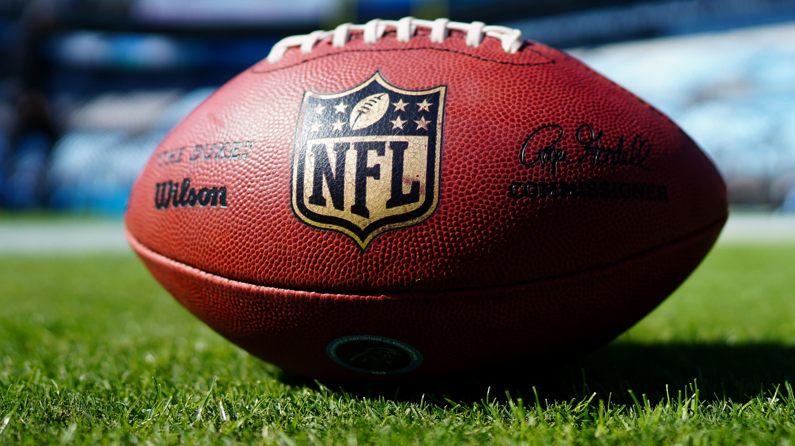
Predicting NFL Postseason Wins Using Machine Learning
CSE 482 Big Data Analysis Project

Slide 2
Team Introduction
Gian Batayola
Brett Geunes

Slide 3
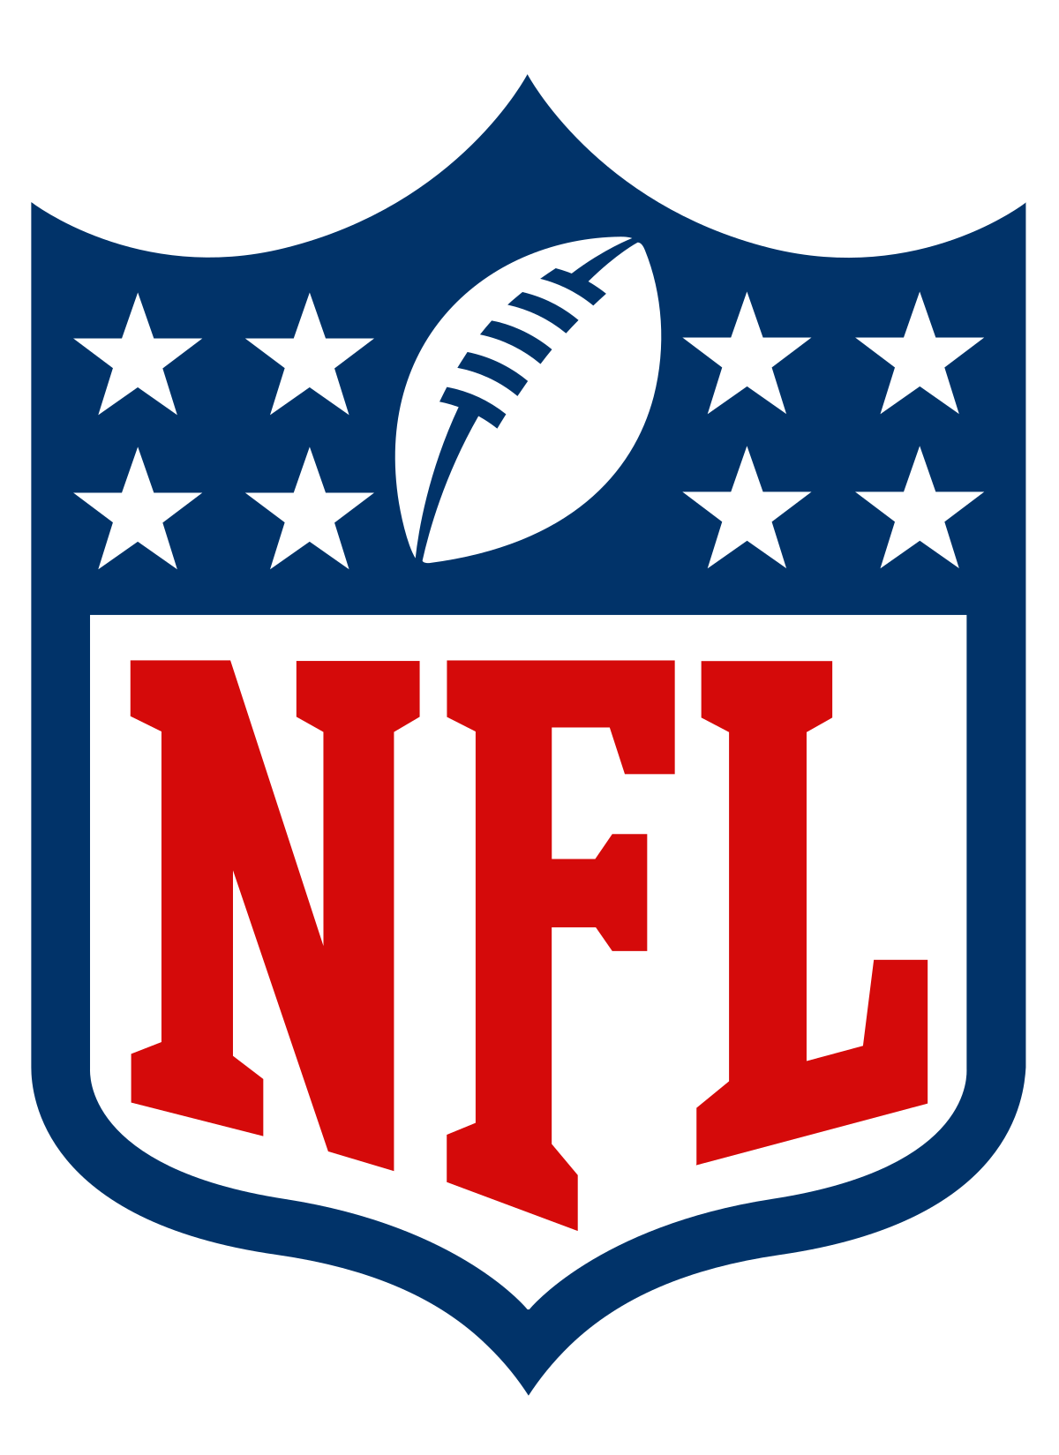
Project Problem
Our project goal was to develop a machine learning model to predict NFL wins.
While this objective stayed constant, our approach varied.
Started using only fantasy defense statistics.
Too restrictive.
Added additional fantasy statistics to help.
Did not provide any new breakthroughs.
Ultimately did not use fantasy statistics at all.
Used individual player statistics.
Most usable and intuitive data.
Provided best performance.

Slide 4

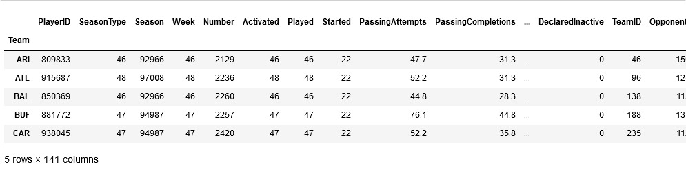
Data Source
For our data, we chose to stream NFL stats using SportsDataIO.
Two endpoints
Player game stats by week
Scores by week
Combination of a team's wins and players over a whole season.
Grouped individual player stats by team
Added wins from scores by week
Used the full 2021 season and 2022 regular season as training data
2022 postseason as the testing data.

Slide 5
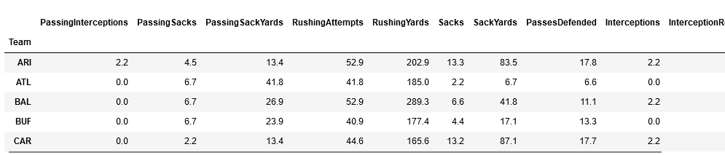
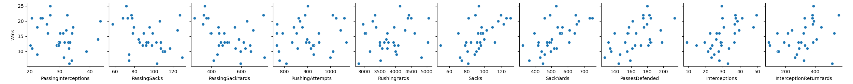
Data Preparation
We cannot immediately use the data as it was collected.
Dropped anything that skewed
Touchdowns, etc.
First attempted PCA
Did not increase accuracy
Use sklearn KBest to select the top 10 most important features.
Metric was ANOVA F-value
Format data to only use these selected features.
Use most relevant features.
Reduce overfitting.
Improve performance.

Slide 6

Model Development
Baseline model
Started with TPOT AutoML
Tries multiple model types and finds the best.
Generations parameter of 5..
Accuracy score of 0.692.
Used as a baseline to test other models.
Tuning model
Decided on support vector machine classifier
Used grid search CV to decide parameters
Regularization parameter of 5
Linear kernel
Training accuracy of 0.721.

Slide 7
Accuracy and Conclusions
Strongest model performance
With our strongest SVM model, we predicted Postseason 2022 wins with 76.9% accuracy
This allowed us to not only predict what team won, but also what abnormal factors are most important to a win
Conclusions to be drawn
The features that made this model the strongest were Passing Interceptions, Passing Sacks, Passing Sack Yards, Rushing Attempts, Rushing Yards, Sacks, Sack Yards, Passes Defended, Interceptions, and Interception Return Yards
In a passing heavy league, defense and rushing give teams the edge in tight games
This information can be used by coaching staffs and scouts to decide which skills to target both in practice and recruiting

Slide 8
Future Work
Build a model that makes predictions based on trends.
Predictions are based on statistics collected after the game completed.
"Reactive" but not "proactive."
Identified what contributes to a win.
Does not account for previous trends.
Winning/losing streaks, bad matchups, etc.
Having separate models for these separate tasks.
Predicting a win based on in-game performance.
Predicting a win based on trends.

Slide 9
Thank you
We will now be taking questions
GitHub link: gianbatayola/CSE482-Project (github.com)

